Slide 1
Journal club
พ.ศรเจน/อ.ณัฐธพงษ์

Slide 2
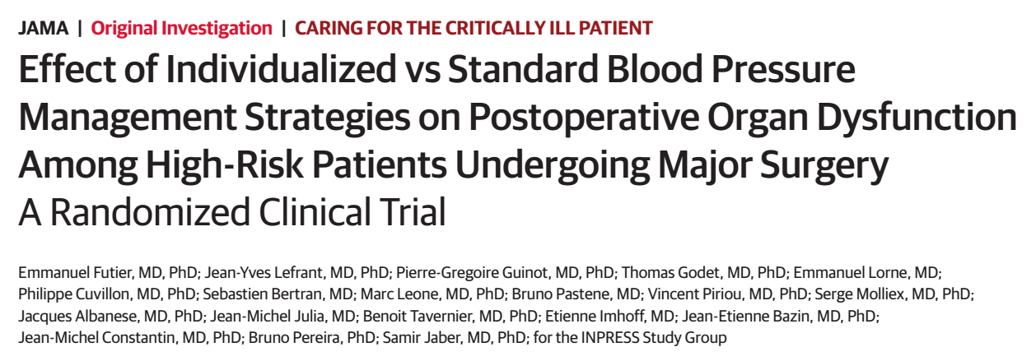

Slide 3
Background
Hemodynamic instability is common during surgery
Intraoperative hypotension is associated with injury to heart, kidney, and brain and an increased likelihood of mortality in high-risk patients
Preventable risk factor as arterial pressure is modifiable using intravenous fluids and/or vasopressors

Slide 4
Chronic hypertension
Organ blood flow may become pressure dependent at higher blood pressure limits due to a possible rightward shift of the organ autoregulation curves
Organs more susceptible to ischemia at low blood pressure

Slide 5
Optimal blood pressure threshold
Systolic blood pressure(SBP) less than 80 mmHg
Mean arterial pressure(MAP) less than 60 mmHg
Reduction of 30% to 50% from baseline

Slide 6
Study Design
Multicenter, parallel-group
Randomized clinical trial
9 French university and nonuniversity hospitals
The trialprotocol was approved for all centers by the ethics committee at the Clermont-Ferrand University Hospital

Slide 7
Study Participants
50 years or older
Scheduled to undergo surgery
Under general anesthesia
Expected duration of 2 hours or longer
ASA PS class 2 or higher
Preoperative acute kidney injury risk index class 3 or higher

Slide 8
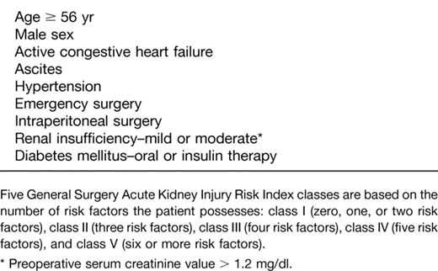
Preoperative acute kidney injury risk index
14. Kheterpal S, Tremper KK, Heung M, et al. Development and validation of an acute kidney injury risk index for patients undergoing general surgery: results from a national data set. Anesthesiology. 2009;110(3):505-515.

Slide 9
Exclusion
Uncontrolled hypertension (SBP ≥180 mm Hg or diastolic blood pressure ≥110 mm Hg)
CKD(GFR<30 mL/min/1.73 m² ) or ESRD
Acute or decompensated heart failure
Acute coronary syndrome
Preoperative sepsis
Already receiving norepinephrine infusion
Required renal vascular surgery
Enrolled in another study

Slide 10
Study Interventions
Resting blood pressure from the preoperative anesthesiology consultation/patient medical record /surgical ward, day before surgery (supine position)
The intervention period from anesthesia induction to 4 hours after completion of surgery
Invasive blood pressure measurement (radial catheter)

Slide 11
Fluid management
Ringer solution was infused rate 4 mL/kg/hour to maintenance fluid requirements
6% hydroxyethyl starch (MW 130 kDa, substitution ratio of 0.4) in 0.9% saline administered in 250-mL boluses to achieve and maintain a maximal value of stroke volume

Slide 12
Standard treatment group
Decrease in SBP below 80 mmHg or lower than 40% from the patient’s reference value
Intravenous ephedrine administered in 6-mg boluses (for a maximum dose not exceeding 60 mg)
After 60 mg of ephedrine, the use of norepinephrine was permitted as rescue therapy

Slide 13
Individualized treatment group
SBP was targeted to remain within ±10% of the reference value
Continuous infusion of norepinephrine (Norepinephrine 2.5 mg in 250 mL of 0.9% saline)

Slide 14
Primary outcome
Systemic inflammatory response syndrome (SIRS) and at least 1 organ dysfunction occurring by day 7 after surgery

Slide 15
Organ dysfunction
Renal (defined by a risk, injury, failure, loss, and end-stage kidney injury [RIFLE] stage of risk or higher)
Respiratory (need for invasive or noninvasive ventilation for respiratory failure)
Cardiovascular (acute cardiac failure or myocardial ischemia or infarction)

Slide 16
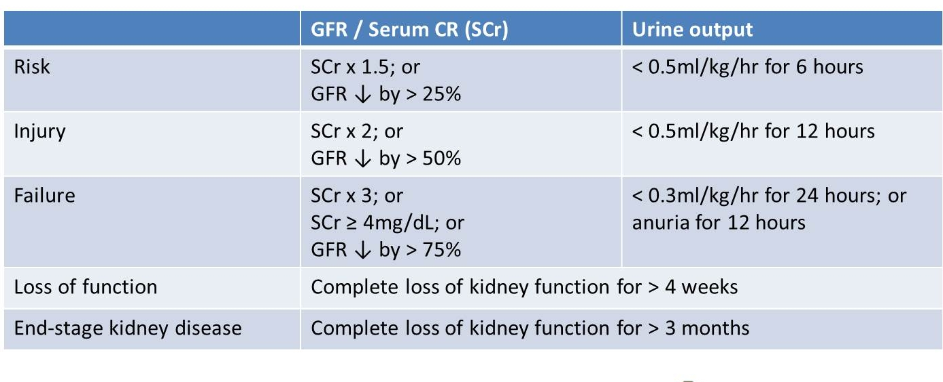
RIFLE criteria

Slide 17
Organ dysfunction
Neurologic (stroke or altered consciousness, defined as a Glasgow Coma Scale score ≤14)
Coagulation (Sequential Organ Failure Assessment [SOFA] subscore ≥2 points in the coagulation component)

Slide 18
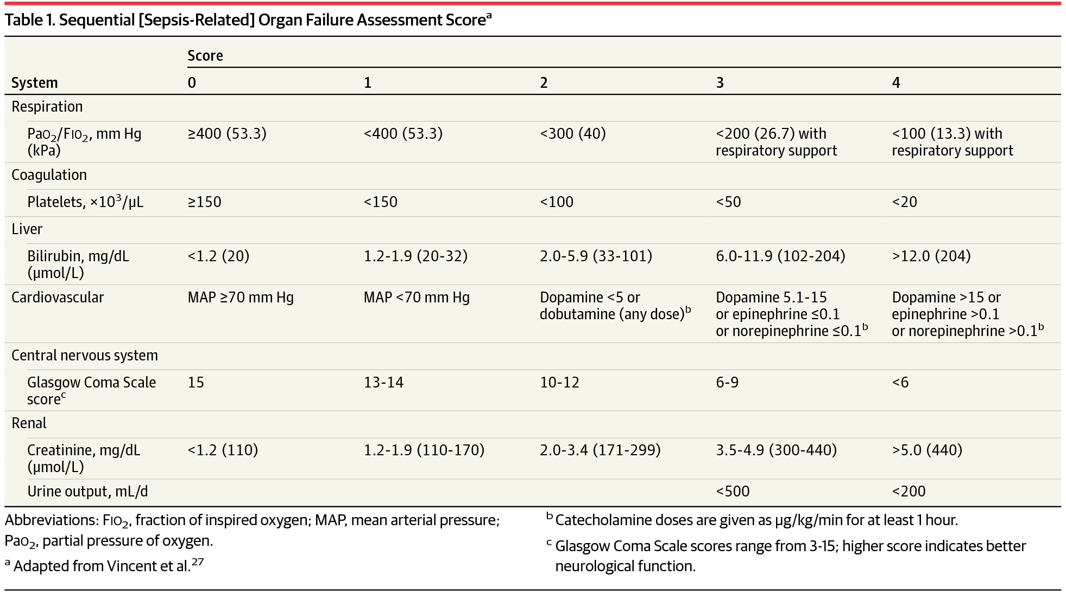
SOFA score

Slide 19
Secondary outcomes
SOFA score on days 1, 2, and 7
SIRS score
Durations of intensive care unit and hospital stay
Postoperative complications at 30 days after surgery
All cause mortality at 30 days after surgery

Slide 20
Postoperative complications
Infectious complications (sepsis, severe sepsis, and septic shock)
Respiratory complications (hypoxemia, pneumonia, need for noninvasive or invasive mechanical ventilation for respiratory failure, ARDS)
Neurologic complications (stroke, altered consciousness)

Slide 21
Postoperative complications
Cardiovascular complications (cardiac arrhythmia, acute heart failure, myocardial infarction)
Surgical complications (anastomotic leak, surgical site infection, reoperation)
Adverse events included severe bradycardia (heart rate <40 beats/min) and major bleeding (transfusion of ≥4 units of red blood cells)

Slide 22
Randomization and Blinding
Enrollment, randomization (1:1 allocation ratio)
Research staff members who collected data during surgery could not be blinded
Strict blinding during the follow-up period and during data collection

Slide 23
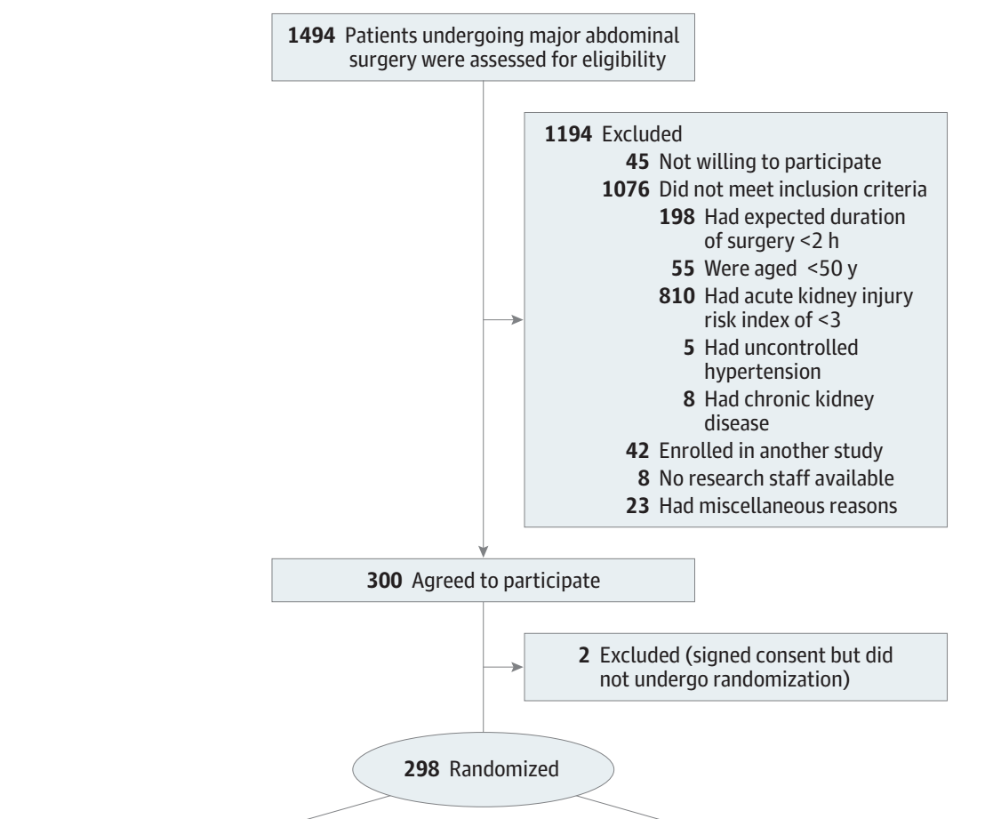

Slide 24
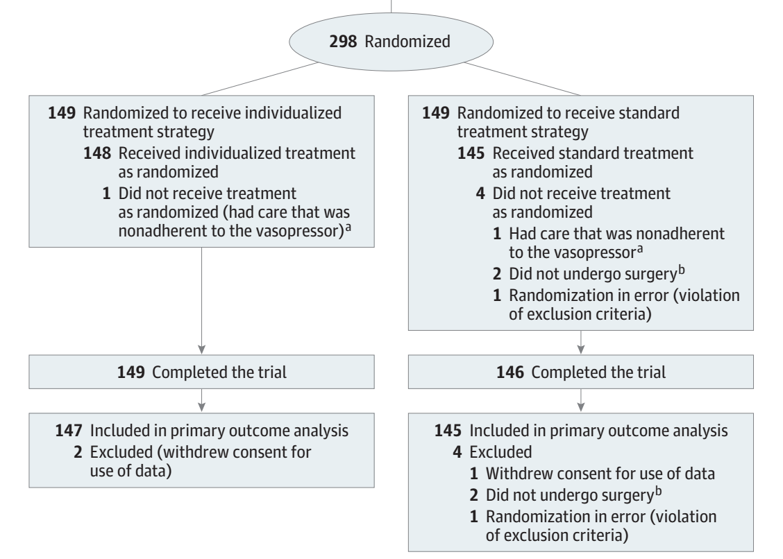

Slide 25
Results

Slide 26
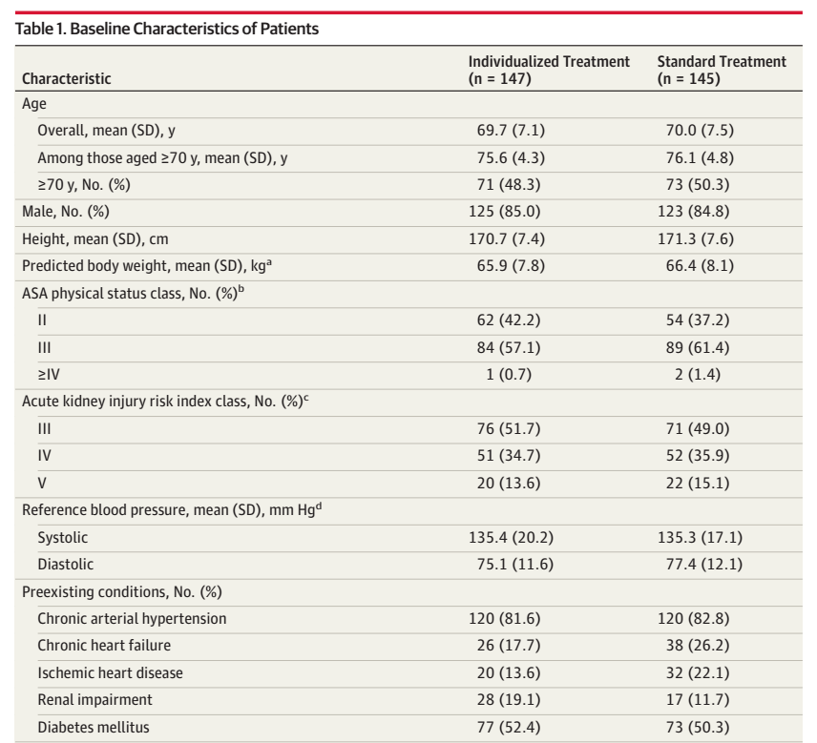

Slide 27
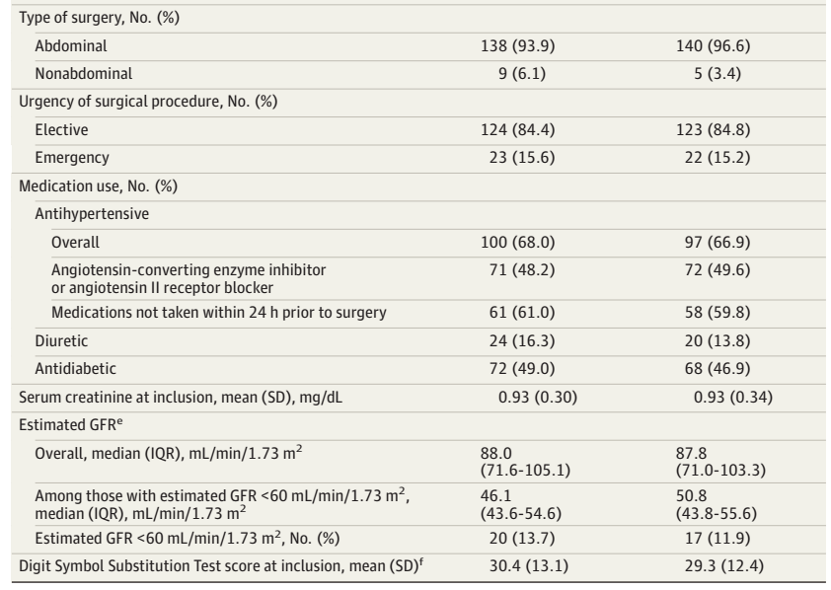

Slide 28
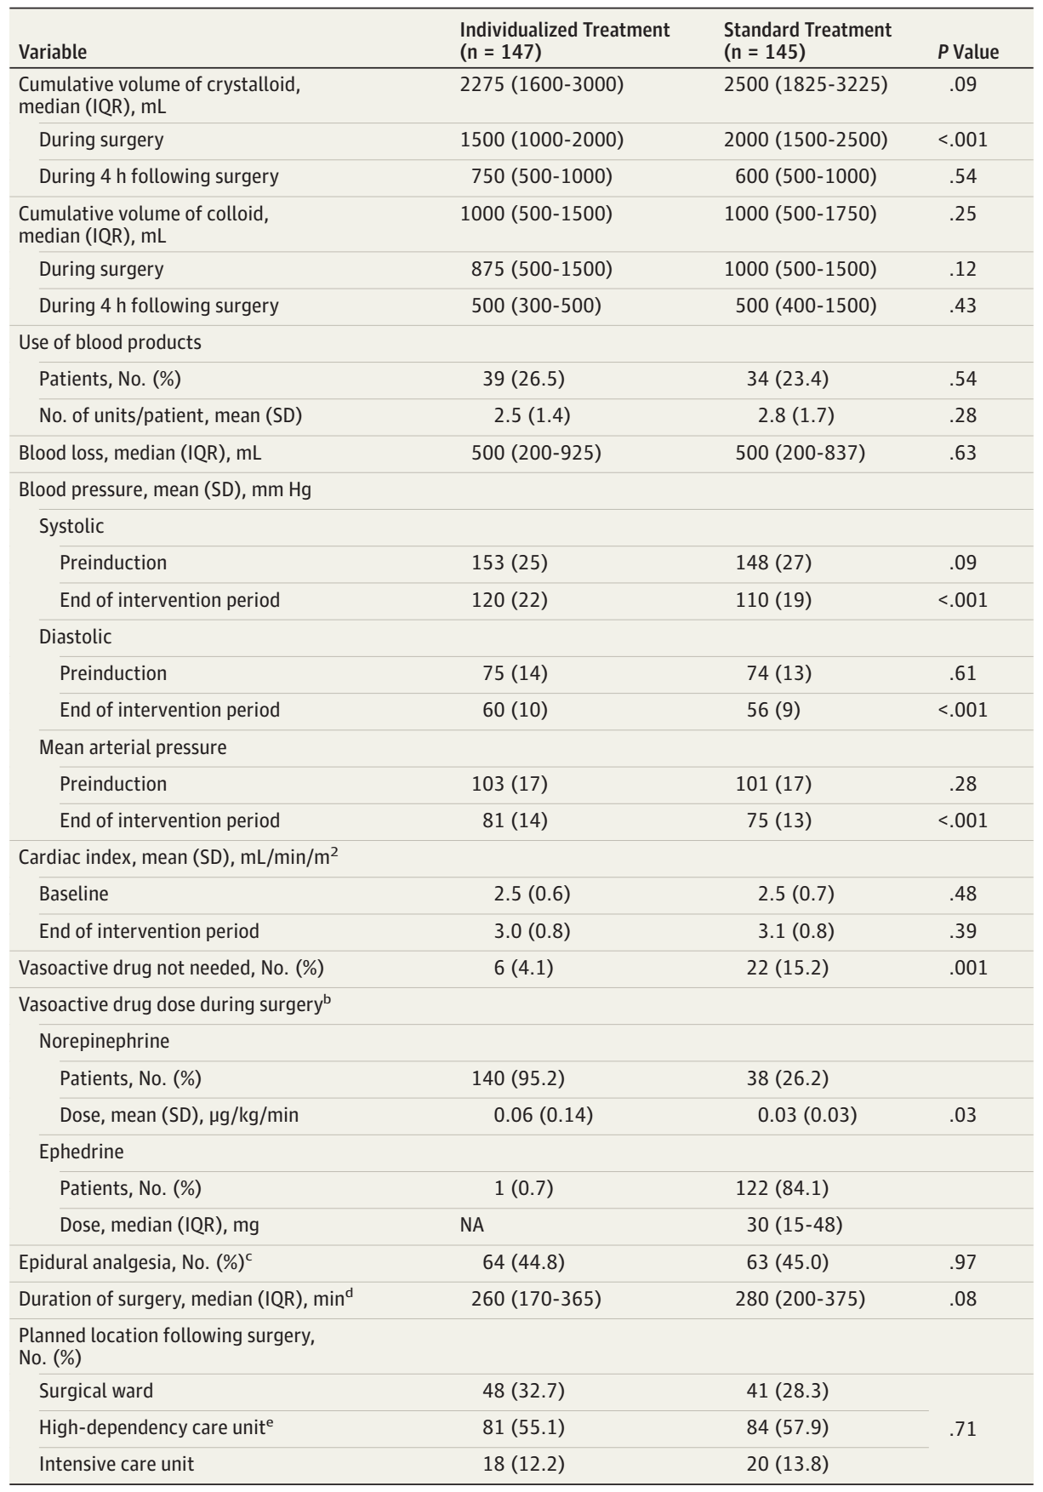

Slide 30
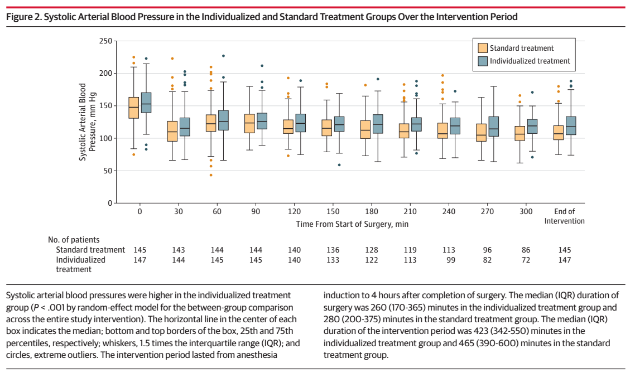

Slide 31
Outcomes

Slide 32
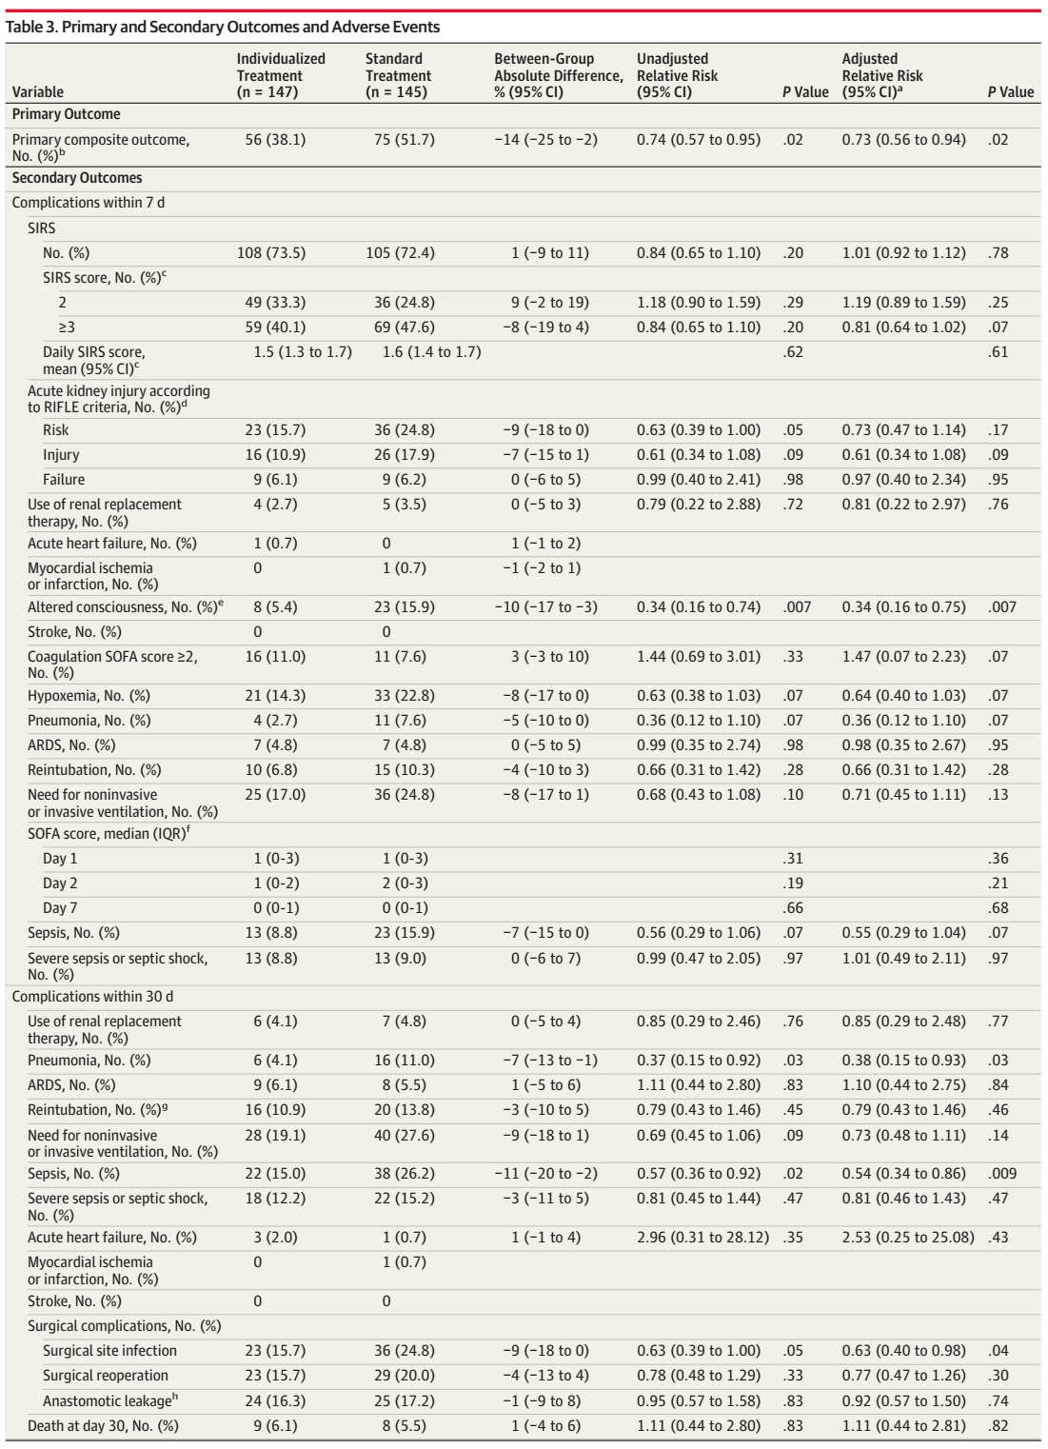

Slide 34
Discussion
Primary outcome that was a composite of SIRS and organ dysfunction with a possible synergism between the components
Postoperative acute kidney injury is related to hypoperfusion and systemic inflammation, is associated with sepsis, coagulopathy, and mechanical ventilation

Slide 35
Discussion
This trial add to the evidence of benefits of personalizing care, especially in high-risk surgical patient
Protection against hypoperfusion relies primarily on maintaining adequate intravascular volume and organ perfusion pressure

Slide 36
Limitation
Hemodynamic data were systematically recorded at 10-minute intervals, but the duration of hypotension events was not recorded
One-quarter of patients required rescue treatment for persistent hypotension in the standard treatment group, the possibility of a longer duration of hypotension cannot be excluded

Slide 37
Limitation
Anesthetic agent not identify
Ephedrine as the first-line vasopressor for standard care, rather than other vasoactive drugs such as phenylephrine(selective α 1-adrenergic agonist)
Hematocrit threshold not identify

Slide 38
Limitation
The intervention could not be blinded
Primary outcome that were not subject to observer bias, and health care workers conducting postoperative care who were unaware of the study assignments
Old criteria of complication

Slide 39
Conclusions
Patients undergoing abdominal surgery who were at increased postoperative risk
Targeting an individualized systolic blood pressure reduced the risk of postoperative organ dysfunction

Slide 40
Clinical appraisal
√
√

Slide 41
Clinical appraisal
√
√

Slide 42
Clinical appraisal
√
√

Slide 43
Clinical appraisal
√
√

Slide 44
Clinical appraisal
√
√

Slide 45
Clinical appraisal
√

Slide 46
Thank you

